Slide 1
Spring REST: Getting Started
INTRODUCTION

Slide 2

What is REST?
What is Spring? Getting Started
Introduction
Basic Messages
Explanation

Slide 3

What is REST?
Representational State Transfer (REST) is an architectural style that defines a set of constraints and properties based on HTTP.
Wikipedia

Slide 4

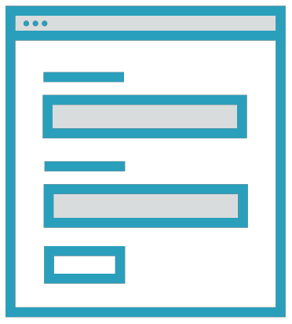
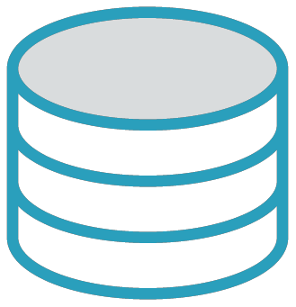




REST
HTTP
JSON
Transfer
JSON
Representational
State
Database
Webform
Data
Data
Client
Server

Slide 5
Client - Server Architecture
Based on HTTP
Request - Response Model
Universal Resource Locator (URL) HTTP Verbs:
GET, POST, PUT, DELETE
REST

Slide 6
HTTP Methods
Method
GET
Description
Retrieve data from the server
POST
Add data to the server
PUT
Modify already existing data
DELETE
Delete data from the server

Slide 7

What is Spring?
The Spring Framework is an application framework and inversion of control container for the Java platform.
Wikipedia

Slide 8
Enterprise Application Framework
Large set of Libraries Spring Boot
Spring MVC Spring Data
Spring Framework

Slide 9
Life Cycle Management
Dependency Injection Build from Configuration
Spring Container
Annotations
Strength Modularity Extensibility

Slide 10
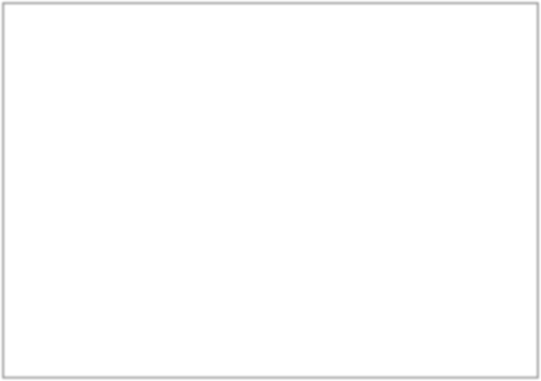
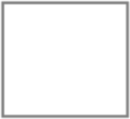



Spring REST Architecture
Model
Data
View
Presentation
Postman
Controller
Request Handing
Service
Database Access
Angular Android iOS
Database
Client
Server

Slide 11

Getting Started
Generate a Demo Project
- http://start.spring.io
Import the Project into IntelliJ Run and Test

Slide 12
Retrieve Data from the Server
Retrieve Data
Request
GET http://localhost:8080/message
Response
{"content": "first message"}
Test with Browser

Slide 13
Send Data to the Server
Send Data
Request
POST http://localhost:8080/message
Data {“content”:”a post message”}
Response
Echo the Request Data
Test with Postman

Slide 14
Explanation
Spring Boot
Container
Run
Restful Web Service
Workflow

Slide 15
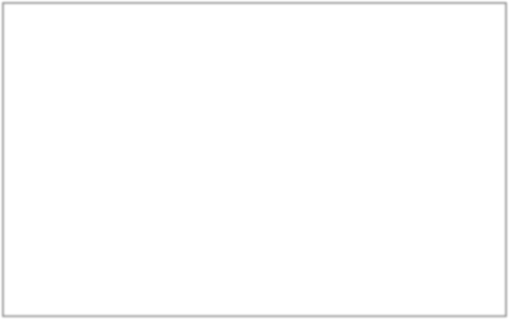




RESTful Web Service
@RequestBody JSON to Java
Request
JSON
Postman
Dispatcher Servlet
@C
ontroller
Java
HTTP
Response
@ResponseBody Java to JSON
Client
Server

Slide 16
REST
Summary
Representational State Transfer
Spring
Enterprise Application Framework
Spring MVC Architecture
Build a REST Web Services
HTTP Methods: GET, POST

Slide 17

JSON types
{
"name": “john",
string
"age": 34,
number
"married": true,
boolean
"children": ["mary", “elsa"],
list
"address": {
"street": “park lane 3", "city": "little town"
},
"unused": null
object
}
null

Slide 18
@GetMapping("/message") Message send() {
return new Message("first message");
}
A Get Mapping
On a “/message GET Request
A Message object is returned

